Slide 1
What is Computer Graphics?
Computer Graphics involves display, manipulation and storage of pictures and experimental data for proper visualization using a computer.
Typical graphics system comprises of a host computer with support of fast processor, large memory, frame buffer
• Display devices (colour monitors)
• Input devices (mouse, keyboard, joystick, touch screen, trackball)
• Output devices (LCD panels, laser printers, colour printers. Plotters etc.)
• Interfacing devices such as, video I/O, TV interface etc.

Slide 2
Applications
Graphs and charts
Computer-Aided Design
Virtual Reality
Data Visualization
Education and training
Computer Art
Movies
Games
Graphical User Interfaces

Slide 3
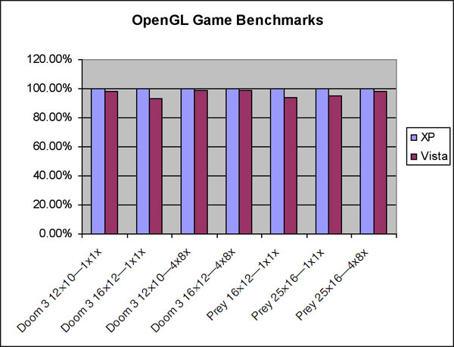
1. Graphs and Charts

Slide 4
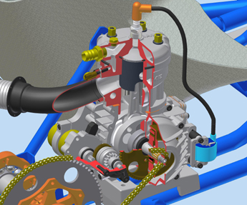
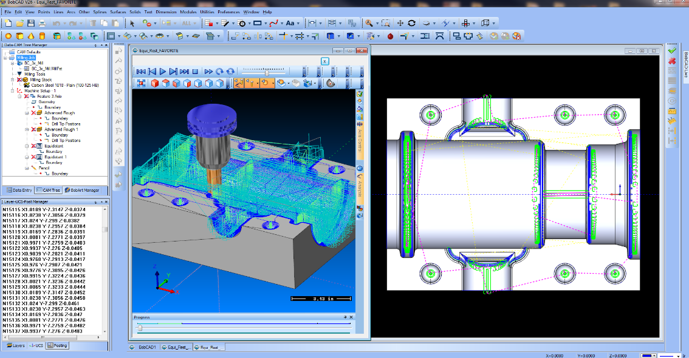
2. Computer Aided Design(CAD/CAM)
Industrial Design
Structural Design
Surface Modeling
AutoDesk
IAME 2-stroke race kart engine

Slide 5
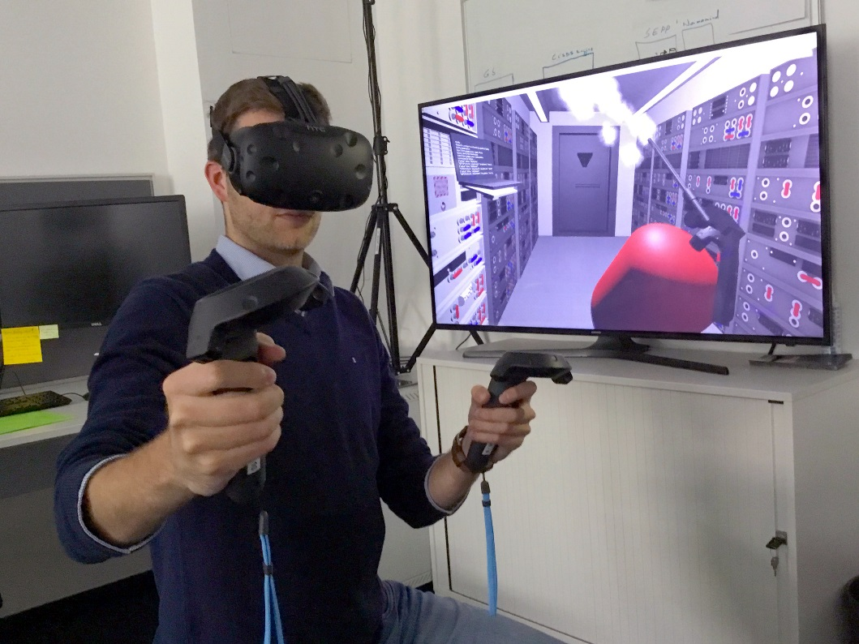
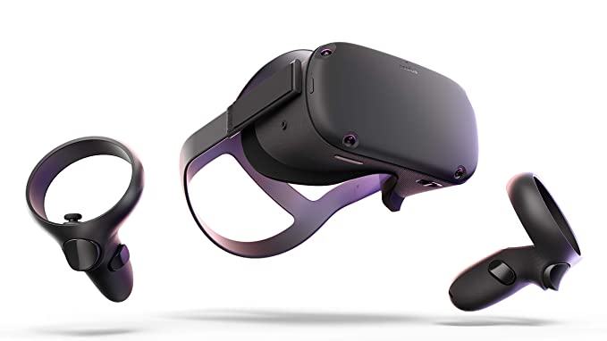
3. Virtual Reality Environment
User interact with objects in 3D environment
Headset and controller is used

Slide 6
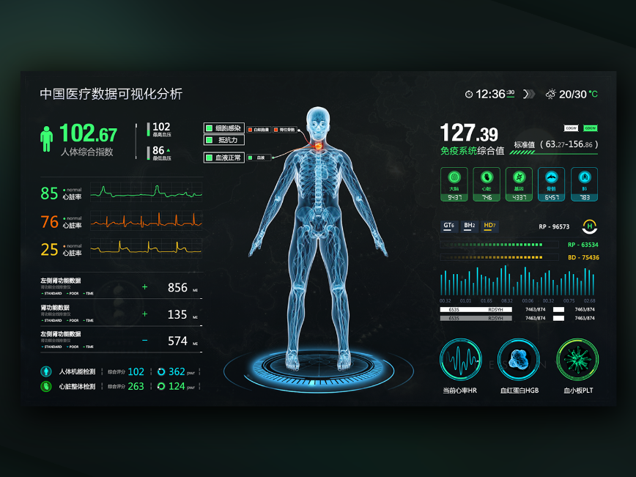
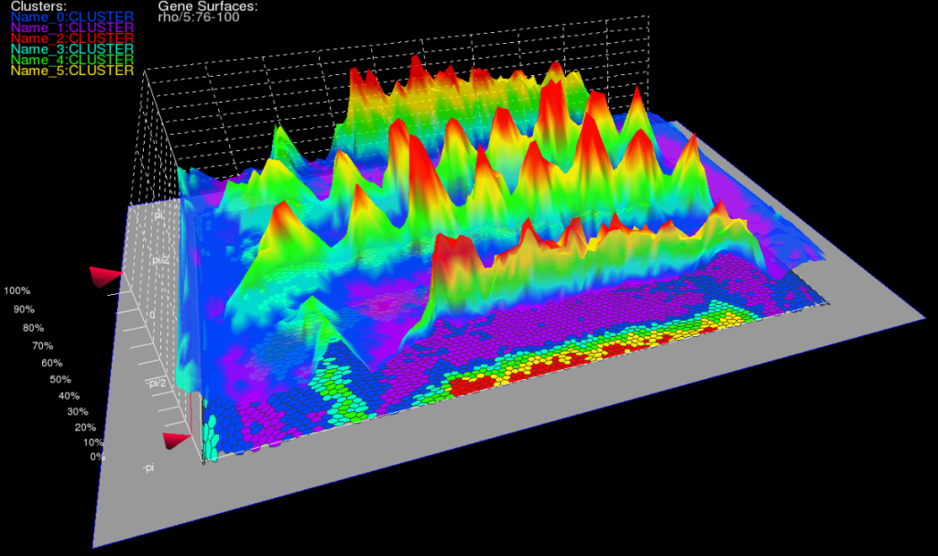
4. Data Visualization
Producing graphical representation for engineering, scientific and medical data sets and processes.
Used by researchers and analysts.

Slide 7
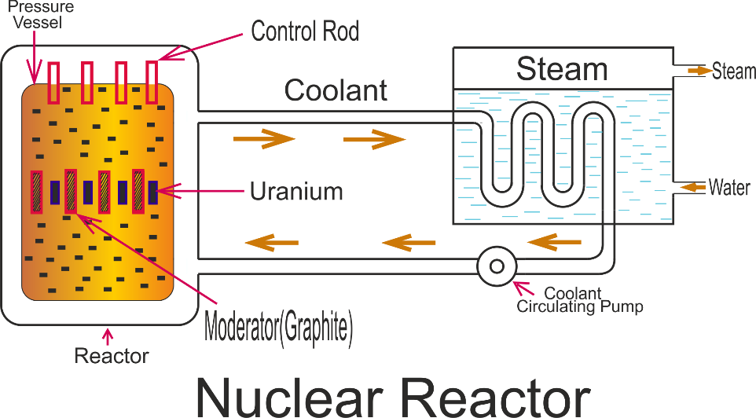
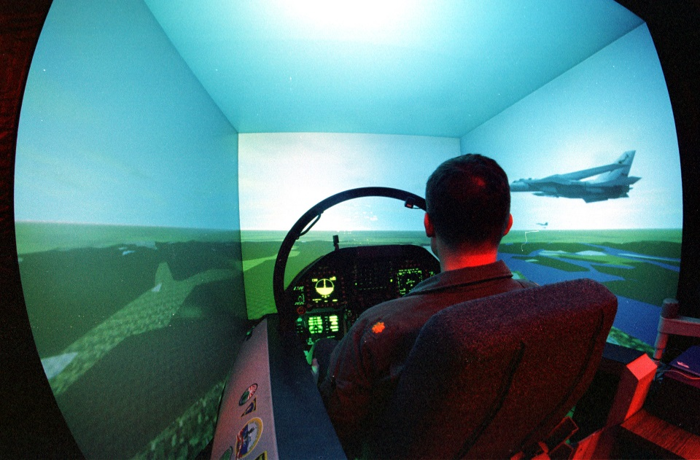
5. Education and Training
Computer generated models of physical, financial, political, social , economic and other systems are often used as educational aids.
Simulators are used for training purposes

Slide 8
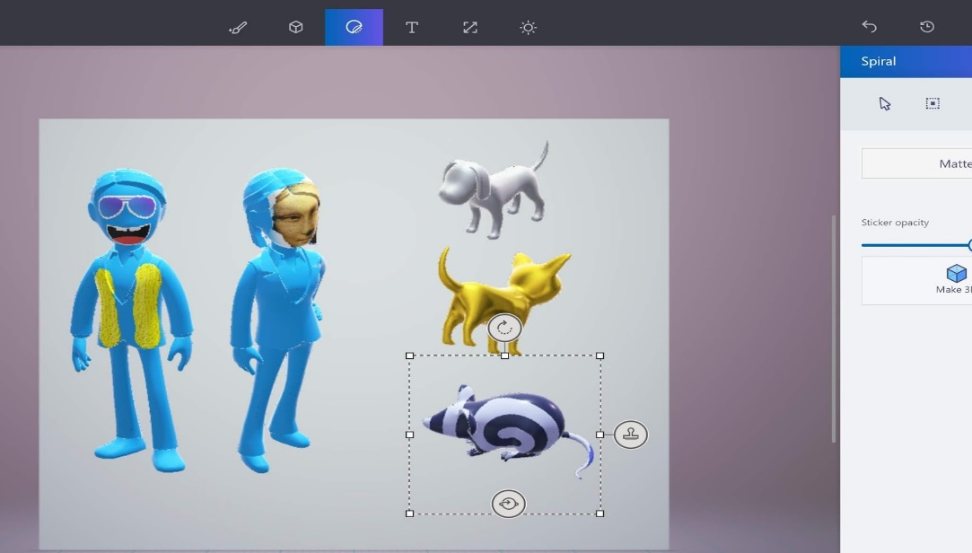
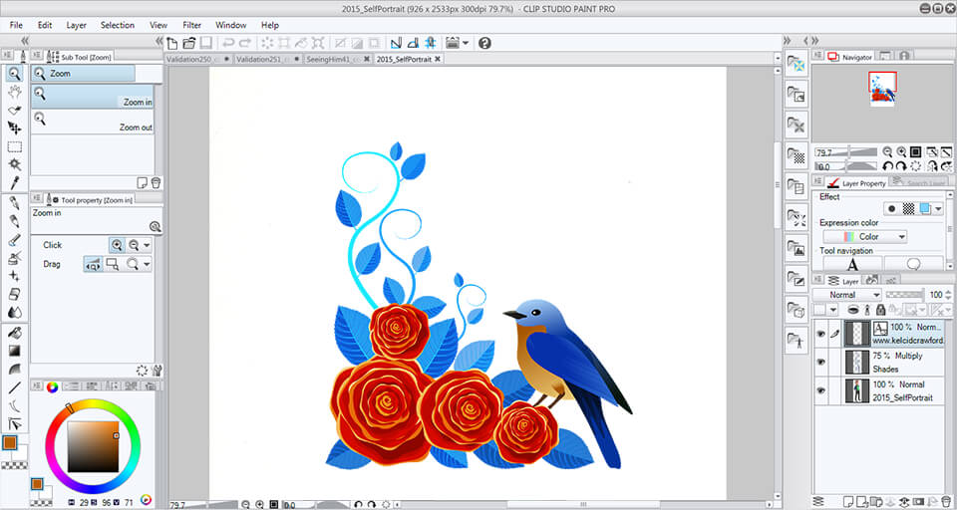
6. Computer ART
Fine art and commercial art can be done using computer graphics.
For example: PAINTBRUSH

Slide 9

7. Entertainment
Television production, motion pictures and music videos routinely uses computer graphics.
Example: VFX

Slide 10

Movies
expression
depth of field
fracture
motion
water
hair
H&B 1:2-32
reflection

Slide 11


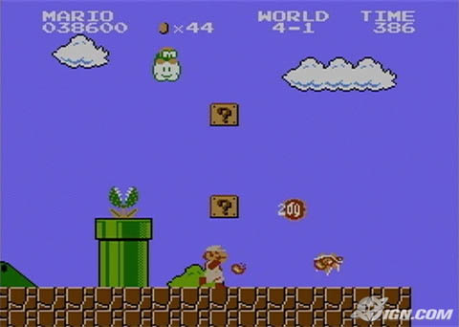
Games

Slide 12
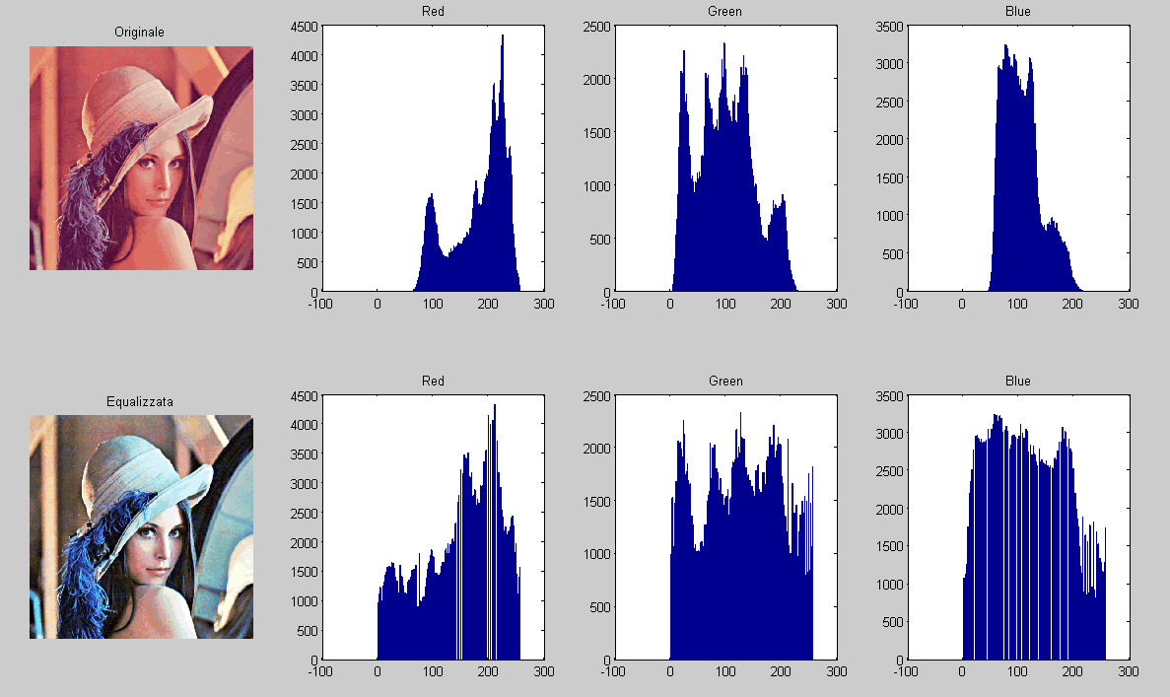
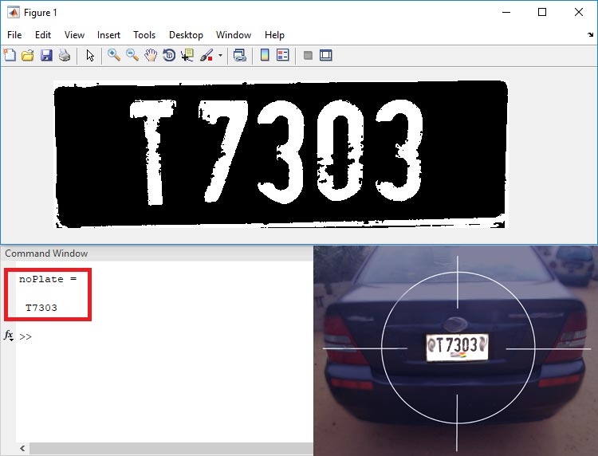
8. Image Processing
Modification and interpretation of existing pictures, such as photographs and TV scans
For Example: CT(computed X-Ray tomography)-SCAN

Slide 13
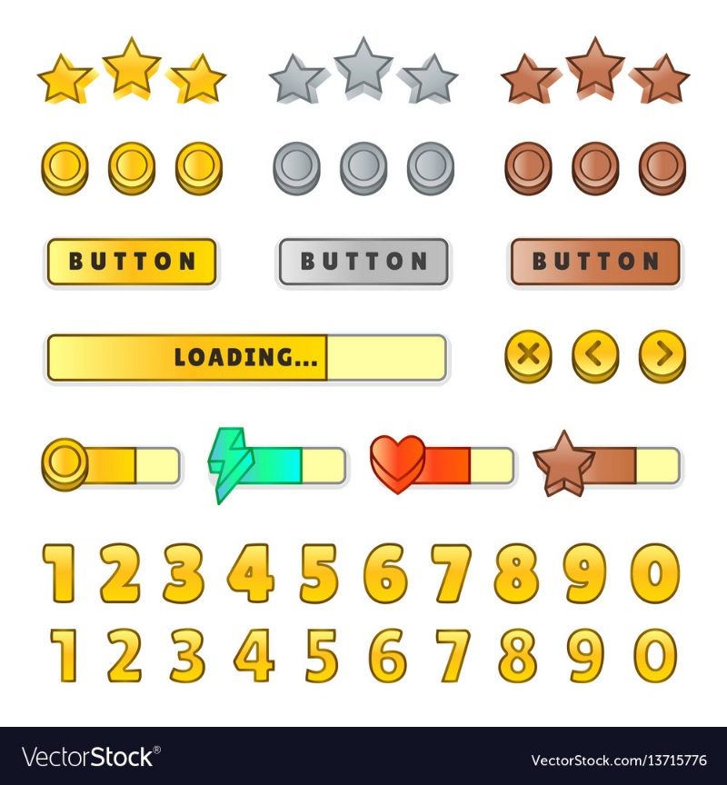

9. Graphical User Interface(GUI)
Provided by application software to users
Window manager that allows user to interact with system
For example: text boxes, buttons etc

Slide 14
Overview of Computer Graphics
Graphics output technology may be split into two categories:
Non-permanent output to a screen (monitors)
Permanent output to a paper (using printer)
Recently all devices are digital in nature:
Therefore, producing images become the process of setting individual points on the screen or on paper
The points are laid out in a regular pattern on the output media.

Slide 15
Video Display Devices
Refresh Cathode-Ray Tubes (CRTs)
Raster-Scan Displays
Random-Scan Displays
Color CRT Monitors
Flat-Panel Displays

Slide 16
Refresh Cathode-Ray Tubes (CRT)
Operation of video monitors is based on standard cathode ray tube(CRT)
A beam of electrons emitted by an electron gun, passes through focusing and deflection systems that direct the beam toward specified positions on the phosphor-coated screen.
Because the light emitted by the phosphor fades very rapidly, the refresh process is needed to maintain the picture on the screen.

Slide 17
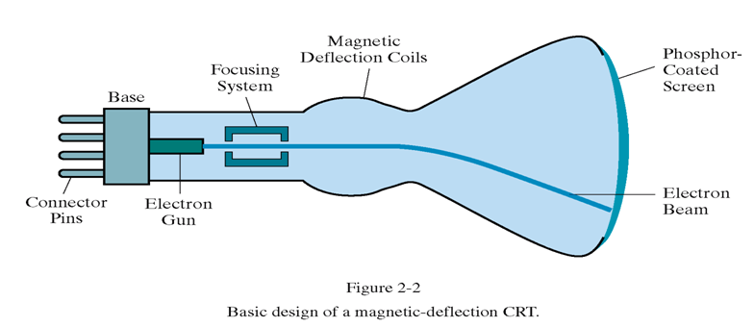
Refresh Cathode-Ray Tubes (CRT)
17

Slide 18
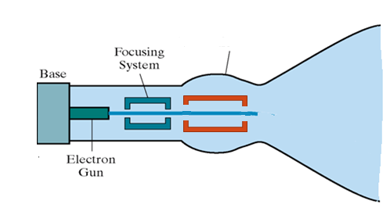
Accelerating Anode
Heating filament
cathode

Slide 19
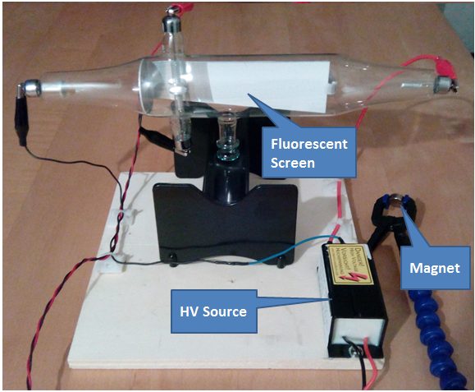
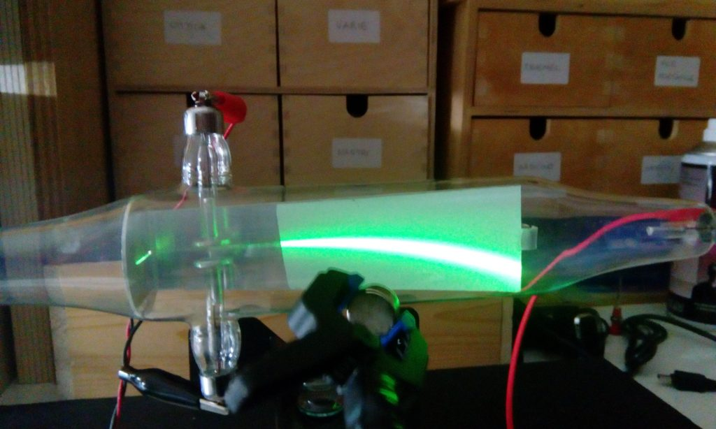

Slide 20
Refresh CRTs
Refreshing is done by redrawing the picture repeatedly by quickly directing the electron beam back over the same screen points.
Refresh rate: the frequency at which a picture is redrawn on the screen.

Slide 21
Working of CRT
Components of the Electron Gun :
The heated metal cathode
A control grid
Heat is supplied to the cathode by directing a current through a coil of wire (the filament) inside the cathode.
This causes electrons to be “boiled off” the hot cathode surface.
Then, the free, negatively electrons are then accelerated towards the phosphor coating by a high positive voltage.

Slide 22
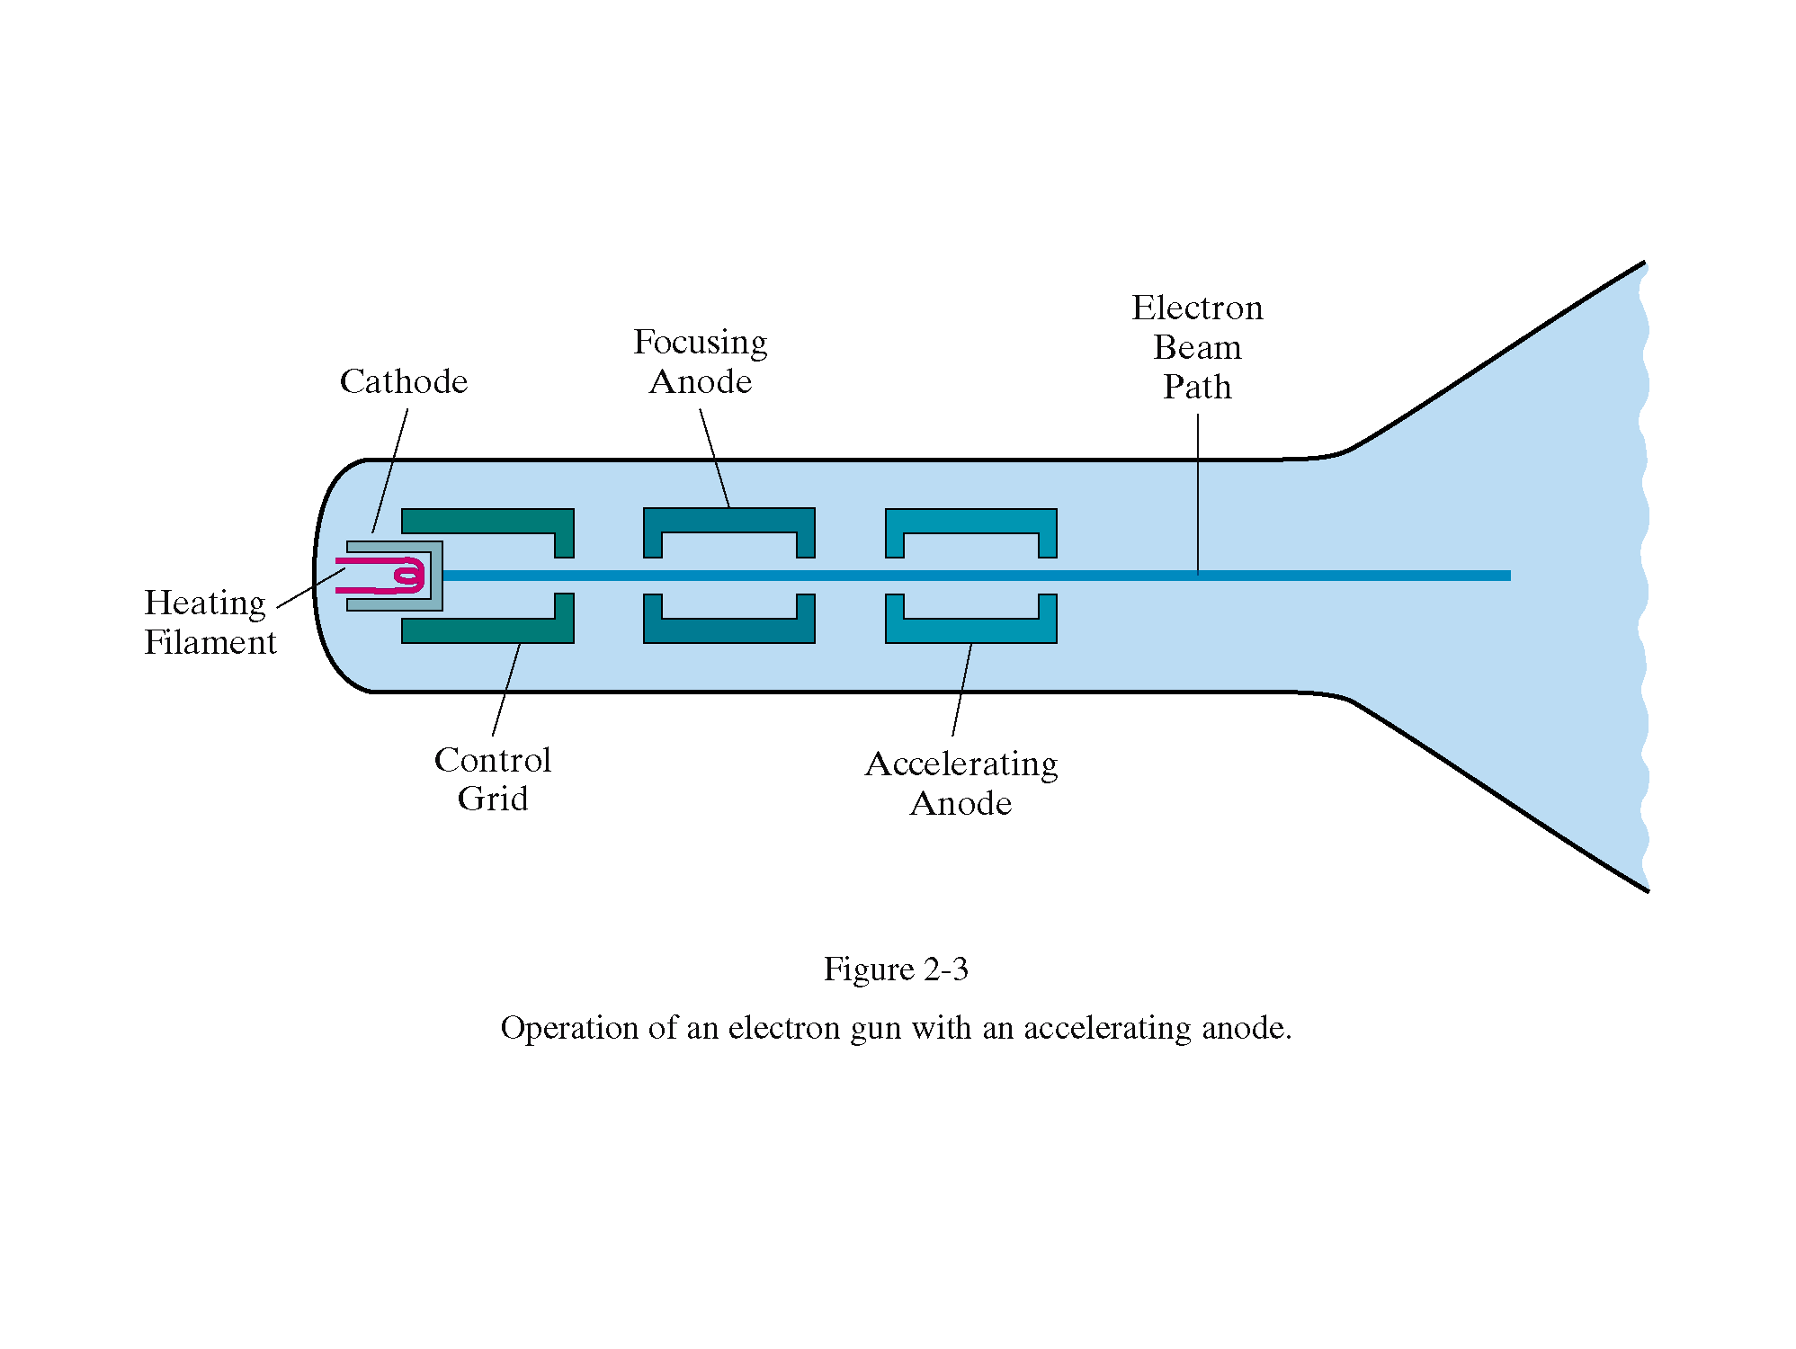
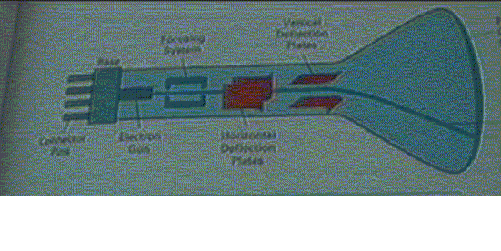
22
Overview of Graphics Systems

Slide 23
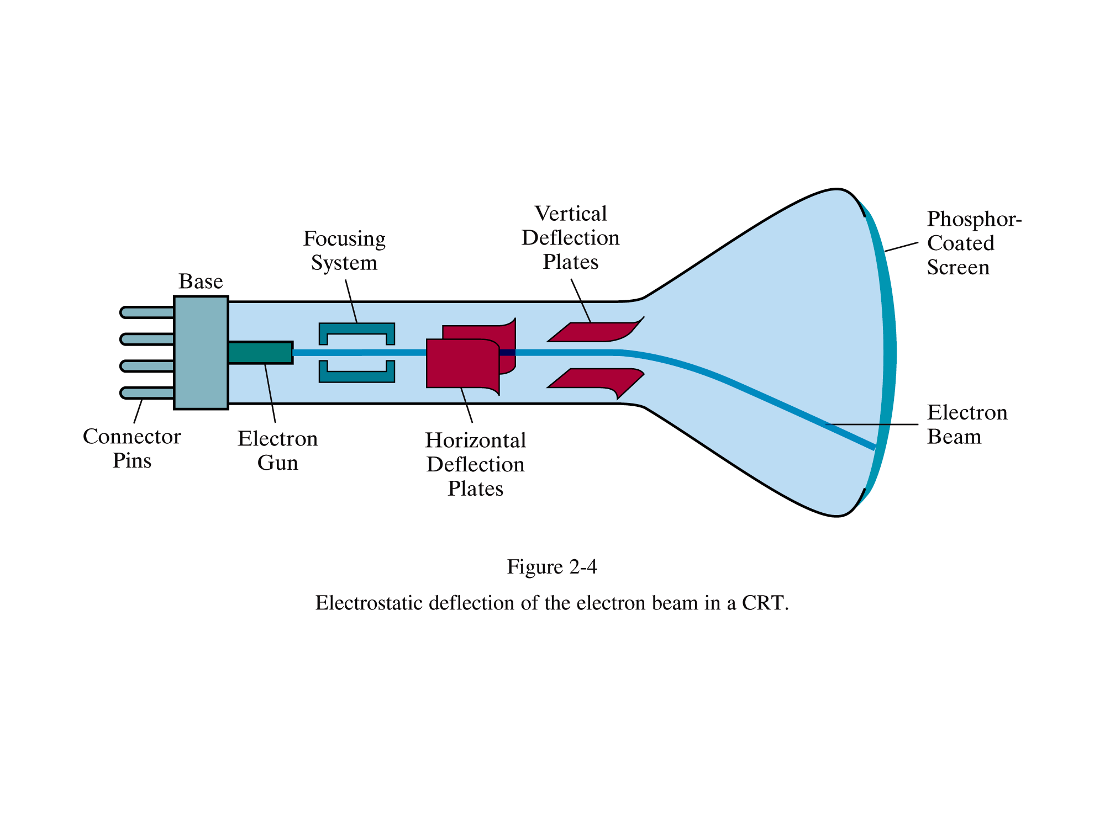
23

Slide 24
Working of CRT
Intensity of the electron beam is controlled by the voltage at the control grid.
A high negative voltage applied to the control grid will shut off the beam.
A smaller negative voltage on the control grid decreases the number of electrons passing through.
The brightness of a display point is controlled by varying the voltage on the control grid.

Slide 25
Working of CRT
Additional focusing hardware is used in high-precision systems to keep the beam in focus at all screen positions.
The distance that the electron beam must travel to different points on the screen varies because the radius of curvature for most CRTs is greater than the distance from the focusing system to the screen centre.
Therefore, the electron beam will be focused properly only at the centre of the screen.
As the beam moves to the outer edges of the screen, displayed images become blurred.
To compensate for this, the system can adjust the focusing according to the screen position of the beam.

Slide 26
Working of CRT
The focusing system forces the electron beam to converge to a small cross section as it strikes the phosphor.
Deflection of the electron beam can be controlled by the deflection coils.
Spots of light are produced on the screen by the transfer of the CRT beam energy to the phosphor.
Different kinds of phosphors are available for use in a CRT.
Persistence: how long phosphors continue to emit light after the CRT beam is removed.

Slide 27
Working of CRT
Persistence is defined as the time that it takes the emitted light from the screen to decay to one-tenth of its original intensity.
Lower-persistence phosphors require high refresh rates to maintain a picture definition on the screen without flicker and they are useful for animation.
Higher-persistence phosphors are useful for displaying highly complex, static pictures.

Slide 28
Few important points
Any given phosphor has several different quantum-levels to which electors can be excited, each corresponding to a color associated with the return to an unexcited state.
Phosphorescence is the light given off by the return of the relatively more stable excited electrons to their unexcited state once the electron beam excitation is removed. It is typically 10-60 microsecond.
As refresh rate decreases , flicker develops because eye can no longer integrate the individual light impulses coming from pixel.
The refresh rate above which a picture stops flickering and fuses into a steady image is called the critical fusion frequency.

Slide 29
Few important points
A flicker free picture appears constant or steady to the viewer.
The longer the persistence, the lower the CFF.
To see the continuously refreshed image without flicker the refresh rate has to be at least 60 Hz.
To allow continuous refreshing of an image there must be some stored representation of the image from which the refresh system can obtain the graphical information required to redraw the image.

Slide 30
Few important points
Resolution: the maximum number of points that can be displayed without overlap on the CRT.
Resolution of the CRT is dependent on the type of phosphor, the intensity to be displayed, and the focusing and deflection systems.
Typical resolution on high-definition systems is 1280 by 1024 (1280*1024)
Another property of video monitors is aspect ratio. This number gives the ratio of vertical points to horizontal points necessary to produce equal-length lines in both directions on the screen. (Sometimes aspect ratio is stated in terms of the ratio of horizontal to vertical points.)
An aspect ratio of 3/4 means that a vertical line plotted with three points has the same length as a horizontal line plotted with four points.

Slide 31
Display Devices:
Graphic monitors that uses CRT technology can be divided in to
Raster scan display
Random scan display

Slide 32
Raster-Scan Displays
The most common type of graphics monitor employing a CRT is the raster-scan display, based on television technology.
In a raster-scan system, the electron beam is swept across the screen, one row at a time from top to bottom.
As the electron beam moves across each row, the beam intensity is turned on and off to create a pattern of illuminated spots.
Picture definition is stored in a memory area called the refresh buffer or frame buffer.
This memory area holds the set of intensity values for all the screen points. Stored intensity values are then retrieved from the refresh buffer and "painted" on the screen one row (scan line) at a time .

Slide 33
Raster-Scan Displays
Each screen point is referred to as a pixel or pel (shortened forms of picture element).
The capability of a raster-scan system to store intensity information for each screen point makes it well suited for the realistic display of scenes containing subtle shading and colour patterns.
Home television sets and printers are examples of other systems using raster-scan methods.
Intensity range for pixel positions depends on the capability of the raster system.
In a simple black-and-white system, each screen point is either on or off, so only one bit per pixel is needed to control the intensity of screen positions

Slide 34
Raster-Scan Displays
Additional bits are needed when colour and intensity variations can be displayed.
Up to 24 bits per pixel are included in high-quality systems, which can require several megabytes of storage for the frame buffer, depending on the resolution of the system.
A system with 24 bits per pixel and a screen resolution of 1024 by 1024 requires 3 megabytes of storage for the frame buffer.
On a black-and-white system with one bit per pixel, the frame buffer is commonly called a bitmap.
For systems with multiple bits per pixel, the frame buffer is Aten referred to as a pixmap.

Slide 35
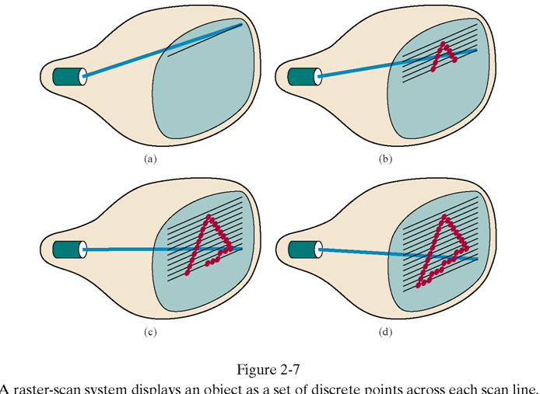
35

Slide 36
Raster-Scan Displays
Refreshing on raster-scan displays is carried out at the rate of 60 to 80 frames per second, although some systems are designed for higher refresh rates.
Sometimes, refresh rates are described in units of cycles per second, or Hertz (Hz), where a cycle corresponds to one frame
At the end of each scan line, the electron beam returns to the left side of the screen to begin displaying the next scan line. The return to the left of the screen, after refreshing each scan line, is called the horizontal retrace of the electron beam.
And at the end of each frame (displayed in 1/80th to 1/60th of a second), the electron beam returns (vertical retrace) to the top left comer of the screen to begin the next frame is called vertical retrace of the electron beam.

Slide 37
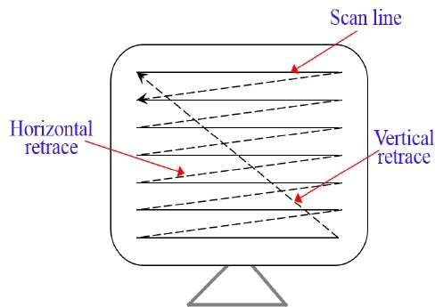
Raster-Scan Displays

Slide 38
Raster-Scan Displays
On some raster-scan systems (and in TV sets), each frame is displayed in two passes using an interlaced refresh procedure. In the first pass, the beam sweeps across every other scan line from top to bottom.
Then after the vertical retrace, the beam sweeps out the remaining scan lines.
Interlacing of the scan lines in this way allows us to see the entire screen displayed in one-half the time it would have taken to sweep across all the lines at once from top to bottom.
Interlacing is primarily used with slower refreshing rates.

Slide 39
Raster-Scan Displays
Advantages:
Realistic image
Million Different colours to be generated
Shadow Scenes are possible.
Disadvantages:
Low Resolution
Expensive

Slide 40
Random-Scan Displays
When operated as a random-scan display unit, a CRT has the electron beam directed only to the parts of the screen where a picture is to be drawn.
Random scan monitors draw a picture one line at a time and for this reason are also referred to as vector displays (or stroke-writing or calligraphic displays).
The component lines of a picture can be drawn and refreshed by a random-scan system in any specified order
A pen plotter operates in a similar way and is an example of a random-scan, hard-copy device.

Slide 41
Random-Scan Displays
Refresh rate on a random-scan system depends on the number of lines to be displayed.
Picture definition is now stored as a set of line drawing commands in an area of memory referred to as the refresh display file.
Sometimes the refresh display file is called the display list, display program, or simply the refresh buffer.
To display a specified picture, the system cycles through the set of commands in the display file, drawing each component line in turn.
After all line drawing commands have been processed, the system cycles back to the first line command in the list.

Slide 42
Random-Scan Displays
Random-scan displays are designed to draw all the component lines of a picture 30 to 60 times each second.
High quality vector systems are capable of handling approximately 100,000 "short" lines at this refresh rate.
When a small set of lines is to be displayed, each refresh cycle is delayed to avoid refresh rates greater than 60 frames per second.
Random-scan systems are designed for line drawing applications and cannot display realistic shaded scenes. Since picture definition is stored as a set of line drawing instructions and not as a set of intensity values for all screen points.

Slide 43
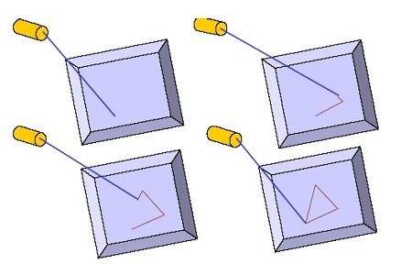

Slide 44
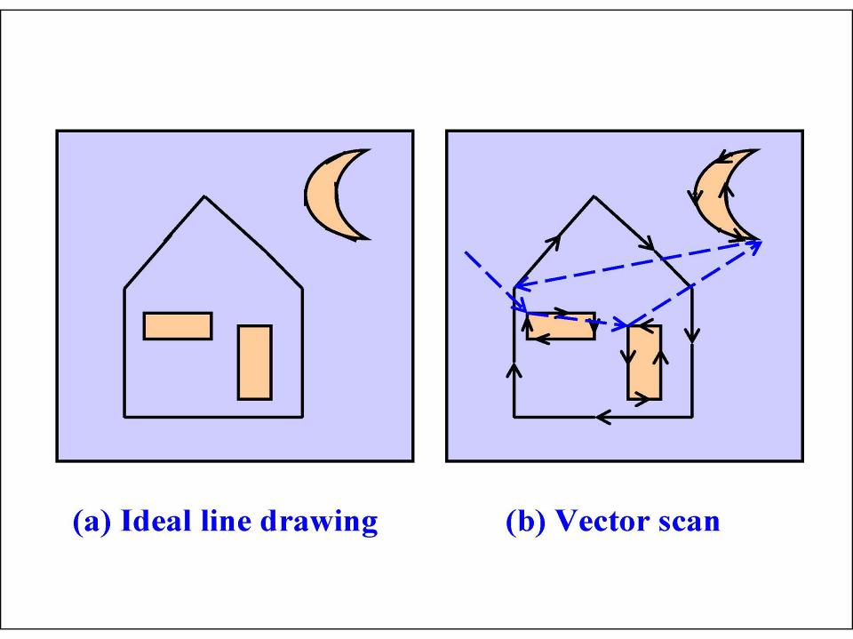
44
Overview of Graphics Systems

Slide 45
Random-Scan Displays
Advantages:
A CRT has the electron beam directed only to the parts of the screen where an image is to be drawn.
Produce smooth line drawings.
High Resolution
Disadvantages:
Random-Scan monitors cannot display realistic shades scenes.

Slide 46
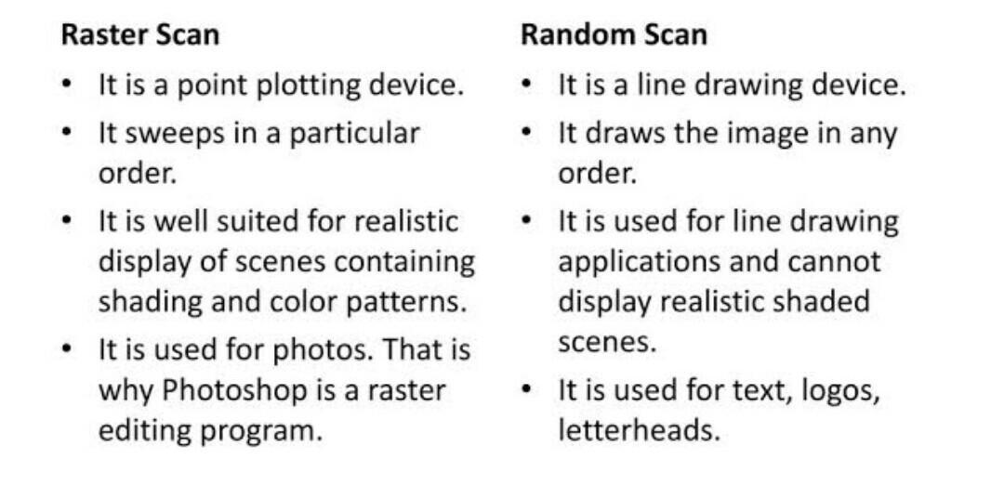
Differentiate between Random and Raster Scan Display:

Slide 47
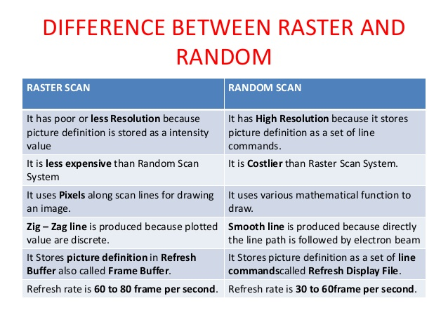

Slide 48
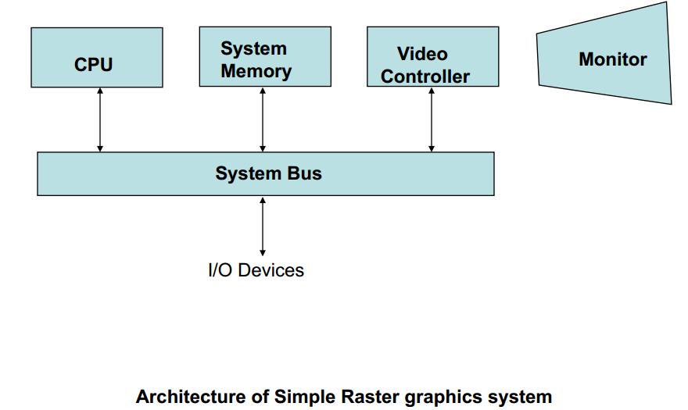
Raster scan system:-
Interactive raster graphics systems typically employ several processing units.
In addition to the central processing unit, or CPU, a special-purpose processor, called the video controller or display controller, is used to control the operation of the display device.

Slide 49
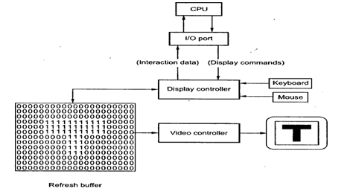
Raster scan system:-

Slide 50
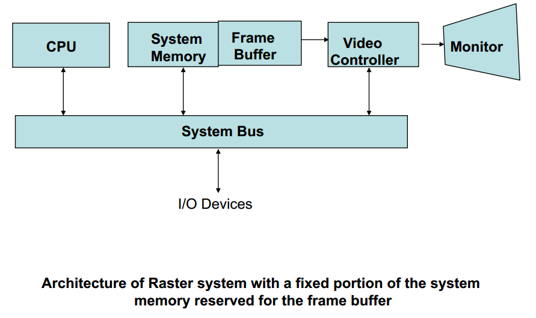
Video Controller

Slide 51
Video Controller
A fixed area of the system memory is reserved for the frame buffer, and the video controller is given direct access to the frame-buffer memory.
Frame-buffer locations, and the corresponding screen positions, are referenced in Cartesian coordinates.
For many graphics monitors, the coordinate originated is defined at the lower left screen corner .
The screen surface is then represented as the first quadrant of a two-dimensional system, with positive x values increasing to the right and positive y values increasing from bottom to top.
A number of other operations can be performed by the video controller, besides the basic refreshing operations

Slide 52
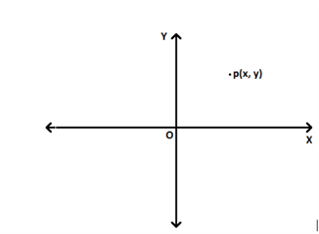

Slide 53
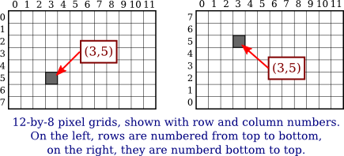
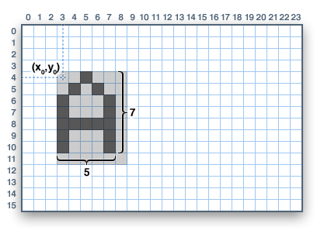
Co-ordinate system

Slide 54
Raster-Scan Display Processor
display processor, sometimes referred to as a graphics controller or a display coprocessor.
The purpose of the display processor is to free the CPU from the graphics chores.
In addition to the system memory, a separate display processor memory area can also be provided.
A major task of the display processor is digitizing a picture definition given in an application program into a set of pixel-intensity values for storage in the frame buffer. This digitization process is called scan conversion.
Display processors are also designed to perform a number of additional operations.
These functions include generating various line styles (dashed, dotted, or solid), displaying colour areas, and performing certain transformations and manipulations on displayed objects. Also, display processors are typically designed to interface with interactive input devices, such as a mouse.

Slide 55
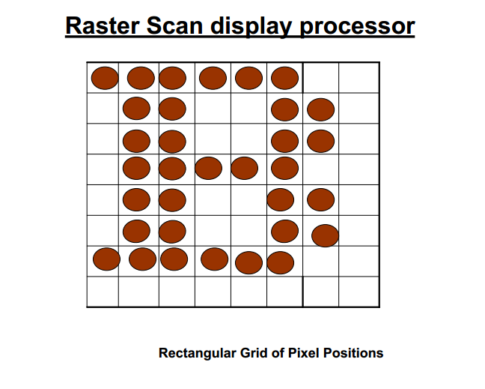

Slide 56
Random Scan Systems
An application program is input and stored in the system memory along with a graphics package.
Graphics commands in the application program are translated by the graphics package into a display file stored in the system memory.
This display file is then accessed by the display processor to refresh the screen.
The display processor cycles through each command in the display file program once during every refresh cycle.
Sometimes the display processor in a random-scan system is referred to as a display processing unit or a graphics controller

Slide 57
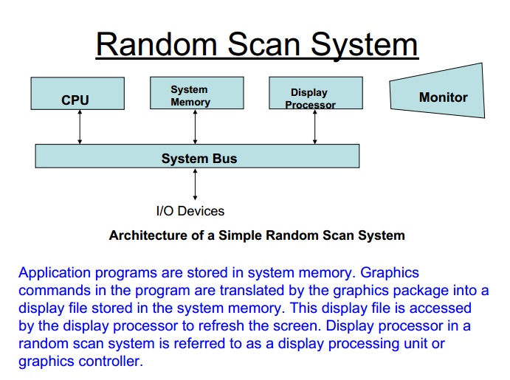

Slide 58
Random Scan Systems
Graphics patterns are drawn on a random-scan system by directing the electron beam along the component lines of the picture.
Lines are defined by the Graphics Monitors values for their coordinate endpoints, and these input coordinate values are converted to x and y deflection voltages.
A scene is then drawn one line at a time by positioning the beam to fill in the line between specified endpoints.

Slide 59
Color CRT Monitors
A CRT monitor displays colour pictures by using a combination of phosphors that emit different-coloured light.
By combining the emitted light from the different phosphors, a range of colours can be generated.
The two basic techniques for producing colour displays with a CRT are
The beam-penetration method
The shadow-mask method

Slide 60
The beam-penetration method
The beam-penetration method for displaying colour pictures has been used with random-scan monitors.
Two layers of phosphor, usually red and green, are coated onto the inside of the CRT screen.
the displayed colour depends on how far the electron beam penetrates into the phosphor layers.
A beam of slow electrons excites only the outer red layer. A beam of very fast electrons penetrates through the red layer and excites the inner green layer.
At intermediate beam speeds, combinations of red and green light are emitted to show two additional colours, orange and yellow.

Slide 61
The beam-penetration method
The speed of the electrons, and hence the screen colour at any point, is controlled by the beam-acceleration voltage.
Beam penetration has been an inexpensive way to produce colour in random-scan monitors, but only four colours are possible, and the quality of pictures is not as good as with other methods

Slide 62
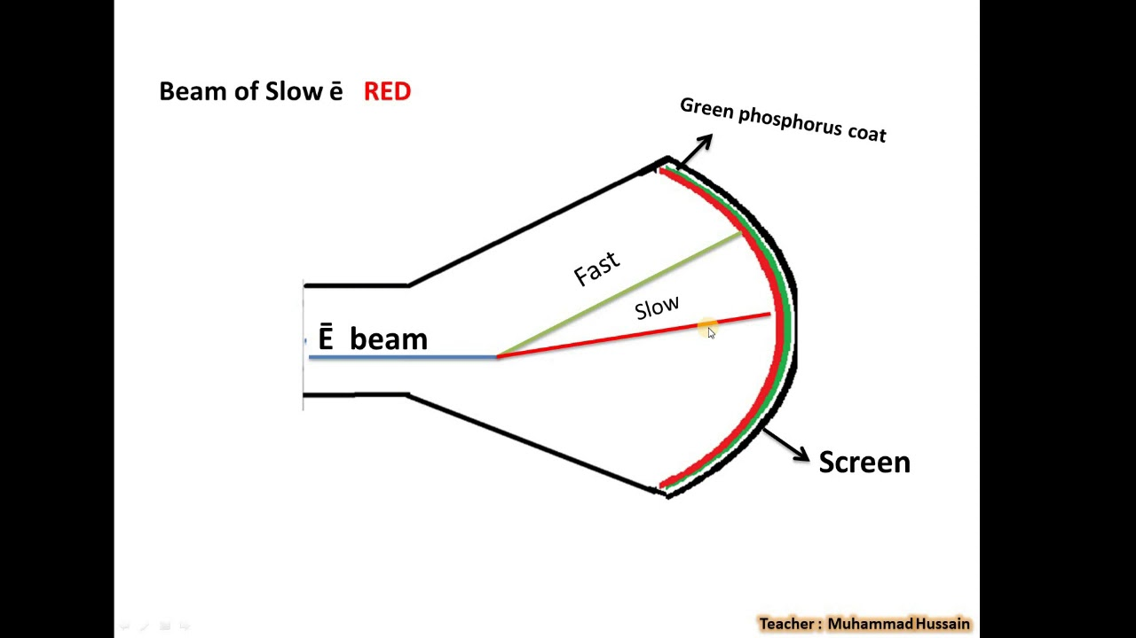
The beam-penetration method

Slide 63
The Beam Penetration method
Advantages
Less expensive
Disadvantages
Quality of images are not good as comparable with other methods
Four colours are allowed only

Slide 64
The shadow-mask method
Shadow-mask methods are commonly used in raster scan systems (including colour TV) because they produce a much wider range of colours than the beam penetration method.
A shadow-mask CRT has three phosphor colour dots at each pixel position. One phosphor dot emits a red light, another emits a green light, and the third emits a blue light.
This type of CRT has three electron guns, one for each colour dot, and a shadow-mask grid just behind the phosphor-coated screen.
The three electron beams are deflected and focused as a group onto the shadow mask, which contains a series of holes aligned with the phosphor-dot patterns.

Slide 65
The shadow-mask method
When the three beams pass through a hole in the shadow mask, they activate a dot triangle, which appears as a small colour spot on the screen.
The phosphor dots in the triangles are arranged so that each electron beam can activate only its corresponding colour dot when it passes through the shadow mask.
Another configuration for the three electron guns is an in-line arrangement in which the three electron guns, and the corresponding red-green-blue colour dots on the screen, are aligned along one scan line instead of in a triangular pattern.
This in-line arrangement of electron guns is easier to keep in alignment and is commonly used in high-resolution colour CRTs.

Slide 66
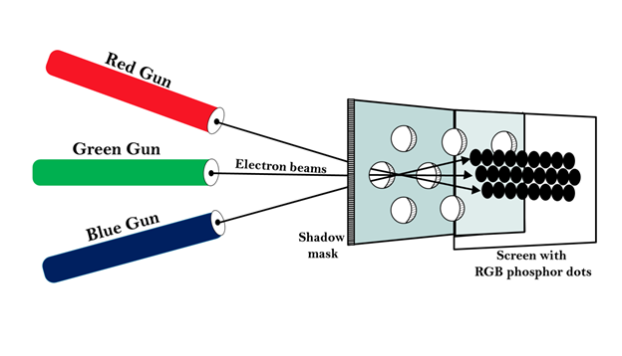
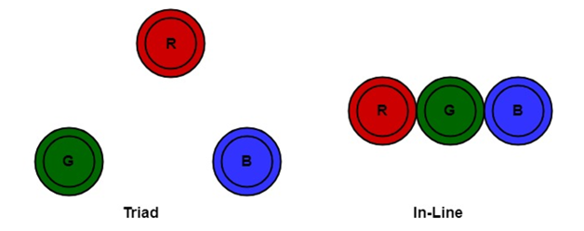
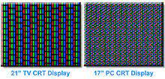
The shadow-mask method

Slide 67
The shadow-mask method
We obtain colour variations in a shadow-mask CRT by varying the intensity levels of the three electron beams. By turning off the red and green guns, we get only the colour coming from the blue phosphor.
Other combinations of beam intensities produce a small light spot for each pixel position, since our eyes tend to merge the three colours into one composite.
The colour we see depends on the amount of excitation of the red, green, and blue phosphors.
A white (or grey) area is the result of activating all three dots with equal intensity. Yellow is produced with the green and red dots only.
In some low-cost systems, the electron beam can only be set to on or off, limiting displays to eight colours.
More sophisticated systems can set intermediate intensity levels for the electron beams, allowing several million different colours to be generated.

Slide 68
The shadow-mask method
Advantages
produce realistic images
also produced different colours
and shadows scenes.
Disadvantages
low resolution
expensive
electron beam directed to whole screen

Slide 69
Direct-View Storage Tubes
An alternative method for maintaining a screen image is to store the picture information inside the CRT instead of refreshing the screen.
A direct-view storage tube (DVST) stores the picture information as a charge distribution just behind the phosphor-coated screen.
Two electron guns are used in a DVST.
One, the primary gun, is used to store the picture pattern;
the second, the flood gun, maintains the picture display.

Slide 70
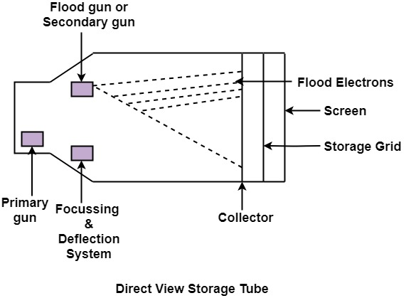
Direct-View Storage Tubes

Slide 71
Direct-View Storage Tubes
A DVST monitor has both disadvantages and advantages.
compared to the refresh CRT. Because no refreshing is needed, very complex pictures can be displayed at very high resolutions without flicker.
Disadvantages of DVST systems are that they ordinarily do not display colour and that selected parts of a picture cannot he erased. To eliminate a picture section, the entire screen must be erased and the modified picture redrawn.
The erasing and redrawing process can take several seconds for a complex picture. For these reasons, storage displays have been largely replaced by raster systems.

Slide 72
Flat-Panel Displays
The term Flat-panel display refers to a class of video devices that have reduced volume, weight, and power requirements compared to a CRT.
A significant feature of flat-panel display is that they are thinner than CRTs, and we can hang them on walls or wear them on our wrists.
Since we can even write on some flat-panel displays.
Current uses for flat-panel displays include TV monitors, calculators, pocket video games, laptop computers, armrest viewing of movies on airlines, as advertisement boards in elevators, and as graphics displays in applications requiring rugged, portable monitors.

Slide 73
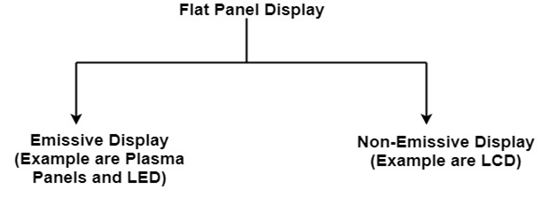
Flat-Panel Displays
We can separate flat-panel displays into two categories: emissive displays and nonemissive displays.
The emissive displays (or emitters) are devices that convert electrical energy into light. Plasma panels, thin-film electroluminescent displays, and Light-emitting diodes are examples of emissive displays.
Examples: Plasma Panel, LED (Light Emitting Diode), Flat CRT.

Slide 74
Flat-Panel Displays
Nonemissive displays (or nonemitters) use optical effects to convert sunlight or light from some other source into graphics patterns. The most important example of a nonemissive flat-panel display is a liquid-crystal device.
Examples: LCD (Liquid Crystal Display)

Slide 75
Plasma panel Display
Plasma panels, also called gas-discharge displays, are constructed by filling the region between two glass plates with a mixture of gases that usually includes neon.
A series of vertical conducting ribbons is placed on one glass panel, and a set of horizontal ribbons is built into the other glass panel.
The essential components of the plasma-panel display are:
Cathode: It consists of line wires. It delivers negative voltage to gas cells. The voltage is released along with the negative axis.
Anode: It also consists of line wires. It delivers positive voltage. The voltage is supplied along positive axis.
Fluorescent cells: It consists of small pockets of gas liquids when the voltage is applied to this liquid (neon gas) it emits light.
Glass Plates: These plates act as capacitors. The voltage will be applied, the cell will glow continuously

Slide 76
Plasma panel Display
The gas will glow when there is a significant voltage difference between horizontal and vertical wires.
The voltage level is kept between 90 volts to 120 volts.
Plasma level does not require refreshing.
Erasing is done by reducing the voltage to 90 volts.
Each cell of plasma has two states, so cell is said to be stable.
Displayable point in plasma panel is made by the crossing of the horizontal and vertical grid.
The resolution of the plasma panel can be up to 512 * 512 pixels

Slide 77
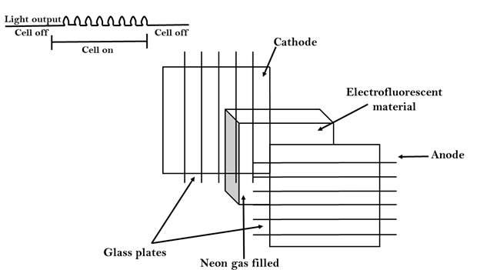
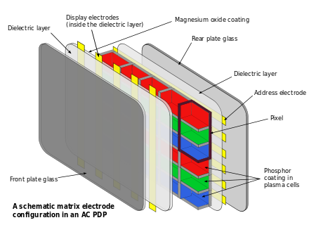
Plasma panel Display

Slide 78
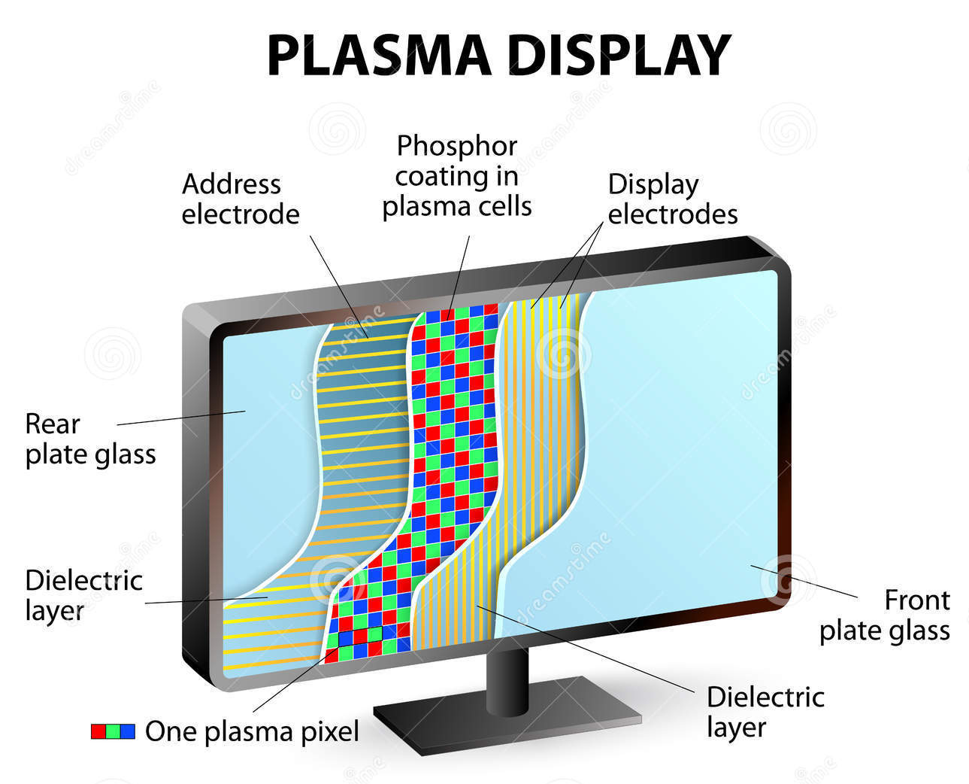

Slide 79
Plasma panel Display
Advantage:
High Resolution
Large screen size is also possible.
Less Volume
Less weight
Flicker Free Display (as no refreshing is required)
Disadvantage:
Wiring requirement anode and the cathode is complex.
Its addressing is also complex.

Slide 80
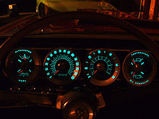
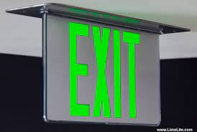
Thin-film electroluminescent displays

Slide 81
Thin-film electroluminescent displays
Thin-film electroluminescent displays are similar in construction to a plasma panel.
The difference is that the region between the glass plates is filled with a phosphor, such as zinc sulphide doped with manganese, instead of a gas
When a sufficiently high voltage is applied to a pair of crossing electrodes, the phosphor becomes a conductor in the area of the intersection of the two electrodes.
Electrical energy is then absorbed by the manganese atoms, which then release the energy as a spot of light.
Electroluminescent displays require more power than plasma panel.
Good colour and Gray scale displays are hard to achieve.

Slide 82
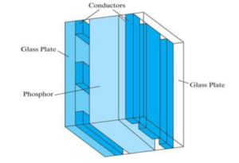
Thin-film electroluminescent displays

Slide 83
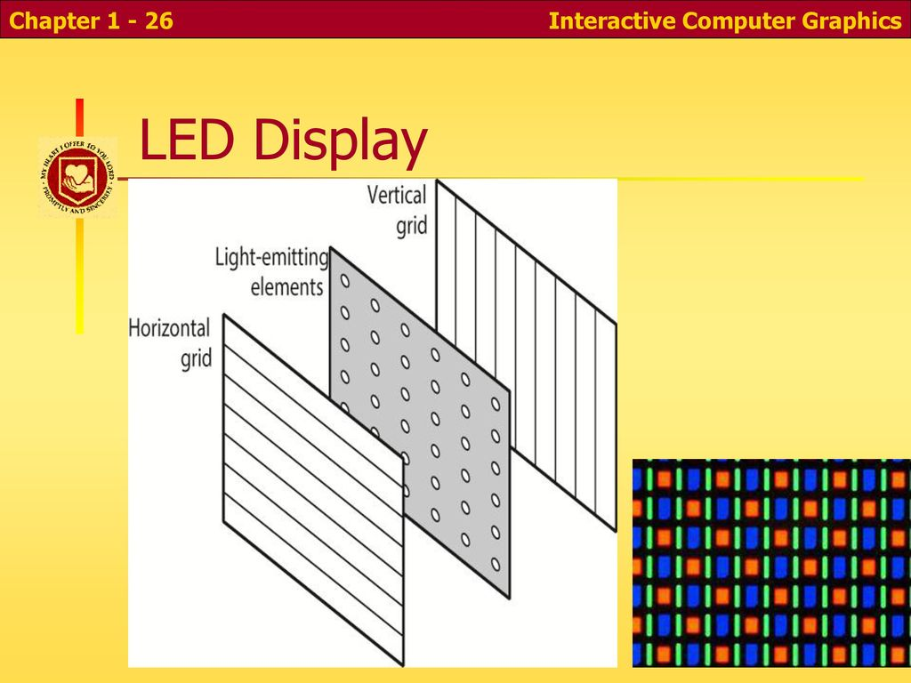
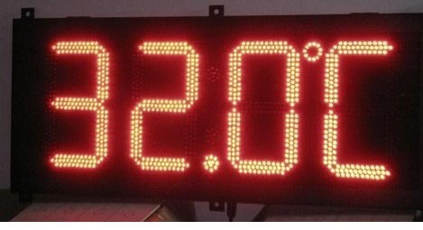
LED (Light Emitting Diode)
A matrix of diodes is arranged to form the pixel positions in the display, and picture definition is stored in a refresh buffer.
Information is read from the refresh buffer and converted to voltage levels that are applied to the diodes to produce the light patterns in the display.

Slide 84


Slide 85
Liquid Crystal Display (LCDS)
The liquid crystal display (LCDS) are commonly used in small systems, such - as calculators and portable, laptop computers.
These nonemissive devices produce a picture by passing polarized light from the surroundings or from an internal light sources through a liquid-crystal material that can be aligned to either block or transmit the light.
The term liquid crystal refers to the fact that these compounds have a crystalline arrangement of molecules, yet they flow like a liquid.
Flat-panel displays commonly use nematic (threadlike) liquid-crystal compounds that tend to keep the long axes of the rod-shaped molecules aligned.

Slide 86


Slide 87




Slide 88
Liquid Crystal Display (LCDS)
A flat-panel display can then be constructed with a nematic liquid crystal.
Two glass plates, each containing a light polarizer at right angles to the-other plate, sandwich the liquid-crystal material.
Rows of horizontal transparent conductors are built into one glass plate, and columns of vertical conductors are put into the other plate.
The intersection of two conductors defines a pixel position.
Normally, the molecules are aligned as shown in the "on state"
Polarized light passing through the material is twisted so that it will pass through the opposite polarizer.
The light is then reflected back to the viewer.

Slide 89

Liquid Crystal Display (LCDS)

Slide 90
Liquid Crystal Display (LCDS)
To turn off the pixel, we apply a voltage to the two intersecting conductors to align the molecules so that the light is not twisted.
This type of flat-panel device is referred to as a passive-matrix LCD.
Picture definitions are stored in a refresh buffer,
screen is refreshed at the rate of 60 frames per second, as in the emissive devices.

Slide 91
Liquid Crystal Display (LCDS)
Back lighting is also commonly applied using solid-state electronic devices, so that the system is not completely dependent on outside light sources.
Colours can be displayed by using different materials or dyes and by placing a triad of colour Pixels at each screen location.
Another method for constructing LCD is to place a transistor at each pixel location, using thin-film transistor technology.
The transistors are used to control the voltage at pixel locations and to prevent charge from gradually leaking out of the liquid-crystal cells. These devices are called active-matrix displays.

Slide 92
Liquid Crystal Display (LCDS)
Advantage:
Low power consumption.
Small Size
Low Cost
Disadvantage:
LCDs are temperature-dependent (0-70°C)
LCDs do not emit light; as a result, the image has very little contrast.
LCDs have no color capability.
The resolution is not as good as that of a CRT.

Slide 93
Three-Dimensional Viewing Devices
Graphics monitors for the display of three-dimensional scenes have been devised using a technique that reflects a CRT image from a vibrating, flexible mirror.
As the varifocal mirror vibrates, it changes focal length.
These vibrations are synchronized with the display of an object on a CRT so that each point on the object is reflected from the mirror into a spatial position corresponding to the distance of that point from a specified viewing position.
This allows us to walk around an object or scene and view it from different sides.

Slide 94

Three-Dimensional Viewing Devices

Slide 95


Slide 96
Stereoscopic and Virtual-Reality Systems
Another technique for representing three dimensional objects is displaying stereoscopic views.
This method does not produce true three-dimensional images, but it does provide a three-dimensional effect by presenting a different view to each eye of an observer so that scenes do appear to have depth
To obtain a stereoscopic projection, we first need to obtain two views of a scene generated from. a viewing direction corresponding to each eye (left and right).
We can construct the two views as computer-generated scenes with different viewing positions, or we can use a stereo camera pair to photograph some object or scene.
When we simultaneous look at the left view with the left eye and the right view with the right eye, the two views merge into a single image and we perceive a scene with depth.

Slide 97

Stereoscopic and Virtual-Reality Systems

Slide 98
Stereoscopic and Virtual-Reality Systems
One way to produce a stereoscopic effect is to display each of the two views with a raster system on alternate refresh cycles.
This is viewed through glasses, with each lens designed to act as a rapidly alternating shutter that is synchronized to block out one of the views.

Slide 99


GRAPHICS MONITORS AND WORKSTATIONS
Most graphics monitors today operate as raster scan displays, and here we survey a few of the many graphics hardware configurations available.
Graphics systems range from small general-purpose computer systems with graphics capabilities to sophisticated full colour systems that are designed specifically for graphics applications.

Slide 100
GRAPHICS MONITORS AND WORKSTATIONS
A typical screen resolution for personal computer systems is 640 by 480.
Screen resolution and other system capabilities vary depending on the size and cost of the system.
Diagonal screen dimensions for general-purpose personal computer systems can range from 12 to 21 inches, and allowable colour selections range from 16 to over 32,000.
For workstations specifically designed for graphics applications typical screen resolution is 1280 by 1024, with a screen diagonal of 16 inches or more.
Graphics workstations can be configured with from 8 to 24 bits per pixel (full-colour systems),with higher screen resolutions, faster processors, and other options available in high-end systems.

Slide 101


GRAPHICS MONITORS AND WORKSTATIONS
high-definition graphics monitor are used in applications such as air traffic control, simulation, medical imaging, and CAD.
This system has a diagonal screen size of 27 inches, resolutions ranging from 2048 by 1536 to 2560 by 2048, with refresh rates of 80 Hz or 60 Hz noninterlaced.

Slide 102

GRAPHICS MONITORS AND WORKSTATIONS
A multiscreen system called the Media Wall, provide wall-sized display area.
This system is designed for applications that require large area displays in brightly lighted environments, such as at trade shows, conventions, retail stores, museums, or passenger terminals.
Media Wall operates by splitting images into a number of Sections and distributing the sections over an array of monitors or projectors using a graphics adapter and satellite control units.
An array of up to 5 by 5 monitors, each with a resolution of 640 by 480, can be used in the Media Wall to provide an overall resolution of 3200 by 2400 for either static scenes or animations.
Scenes can be displayed behind mullions or the mullions can be eliminated to display a continuous picture with no breaks between the various sections.

Slide 103
GRAPHICS MONITORS AND WORKSTATIONS
Many graphics workstations, such as some of those are configured with two monitors.
One monitor can be used to show all features of an object or scene, while the second monitor displays the detail in some part of the picture.
Another use for dual-monitor systems is to view a picture on one monitor and display graphics options (menus) for manipulating the picture components on the other monitor.
interactive graphics workstations containing multiple input and other devices. A typical setup for CAD applications.
Various keyboards, button boxes, tablets, and mice are attached to the video monitors for use in the design process.

Slide 104

Input Devices
The Input Devices are the hardware that is used to transfer input to the computer.
The data can be in the form of text, graphics, sound, and video. Output device display data from the memory of the computer. Output can be text, numeric data, line, polygon, and other objects.

Slide 105

Input Devices

Slide 106
Keyboards
An alphanumeric keyboard on a graphics system is used primarily as a device for entering text strings.
The keyboard is an efficient device for inputting such nongraphic data as picture labels associated with a graphics display.
Keyboards can also be provided with features to facilitate entry of screen coordinates, menu selections, or graphics functions.
Cursor-control keys and function keys are common features on general purpose keyboards.
Function keys allow users to enter frequently used operations in a single keystroke, and cursor-control keys can be used to select displayed objects or coordinate positions by positioning the screen cursor.
Other types of cursor-positioning devices, such as a trackball or joystick, are included on some keyboards
Additionally, a numeric keypad is often included on the keyboard for fast entry of numeric data.

Slide 107



Keyboards

Slide 108
Keyboards
For specialized applications, input to a graphics application may come from a set of buttons, dials, or switches that select data values or customized graphics operations.
Buttons and switches are often used to input predefined functions, and dials are common devices for entering scalar values.
Real numbers within some defined range are selected for input with dial rotations.
Potentiometers are used to measure dial rotations, which are then converted to deflection voltages for cursor movement.

Slide 109



Slide 110
Mouse
A mouse is small hand-held box used to position the screen cursor.
Wheels or rollers on the bottom of the mouse can be used to record the amount and direction of movement.
Another method for detecting mouse motion is with an optical sensor.
For these systems, the mouse is moved over a special mouse pad that has a grid of horizontal and vertical lines.
The optical sensor detects movement across the lines in the grid.
Since a mouse can be picked up and put down at another position without change in cursor movement, it is used for making relative change in the position of the screen cursor.
One, two, or three buttons m usually included on the top of the mouse for signalling the execution of some operation, such as recording cursor position or invoking a function.
Most general-purpose graphics systems now include a mouse and a keyboard as the major input devices.

Slide 111




Slide 112
Mouse
Additional devices can be included in the basic mouse design to increase the number of allowable input parameters.
The Z mouse in includes three buttons, a thumbwheel on the side, a trackball on the top, and a standard ,mouse ball underneath.
This design provides six degrees of freedom to select Input Devices spatial positions, rotations, and other parameters.
With the Z mouse, we can pick up an object, rotate it, and move it in any direction, or we can navigate our viewing position and orientation through a three dimensional scene.
Applications of the Z mouse include virtual reality, CAD, and animation.

Slide 113

Mouse

Slide 114
Trackball and Spaceball
As the name implies, a trackball is a ball that can be rotated with the fingers or palm of the hand, to produce screen-cursor movement.
Potentiometers, attached to the ball, measure the amount and direction of rotation.
Trackballs are often mounted on keyboards or other devices such as the Z mouse .
While a trackball is a two-dimensional positioning device, a space ball provides six degrees of freedom. Unlike the trackball, a space ball does not actually move.
Strain gauges measure the amount of pressure applied to the spaceball to provide input for spatial positioning and orientation as the ball is pushed or pulled in various directions.
Spaceballs are used for three-dimensional positioning and selection operations in virtual-reality systems, modelling, animation, CAD, and other applications.

Slide 115


Trackball and Spaceball

Slide 116
Joysticks
A joystick consists of a small, vertical lever (called the stick) mounted on a base that is used to steer the screen cursor around.
Most joysticks select screen positions with actual stick movement; others respond to pressure on the stick.
Some joysticks are mounted on a keyboard; others functions as stand-alone units.
The distance that the stick is moved in any direction from its centre position corresponds to screen-cursor movement in that direction.
Potentiometers mounted at the base of the joystick measure the amount of movement, and springs return the stick to the centre position when it is released.
One or more buttons can be programmed to act as input switches to signal certain actions once a screen position has been selected.

Slide 117




Slide 118
Joysticks
In another type of movable joystick, the stick is used to activate switches that cause the screen cursor to move at a constant rate in the direction selected.
Eight switches, arranged in a circle, are sometimes provided, so that the stick can select any one of eight directions for cursor movement.
Pressure sensitive joysticks, also called isometric joysticks, have a non movable stick.
Pressure on the stick is measured with strain gauges and converted to movement of the cursor in the direction specified.

Slide 119
Data Glove
data glove that can be used to grasp a "virtual" object.
The glove is constructed with a series of sensors that detect hand and finger motions.
Electromagnetic coupling between transmitting antennas and receiving antennas is used to provide information about the position and orientation of the hand.
The transmitting and receiving antennas can each be structured as a set of three mutually perpendicular coils, forming a three-dimensional Cartesian coordinate system.
Input from the glove can be used to position or manipulate objects in a virtual scene.
A two-dimensional projection of the scene can be viewed on a video monitor, or a three-dimensional projection can be viewed with a headset.

Slide 120




Slide 121
Digitizers
A common device for drawing, painting, or interactively selecting coordinate positions on an object is a digitizer.
These devices can be used to input coordinate values in either a two-dimensional or a three-dimensional space.
Typically, a digitizer is used to scan over a drawing or object and to input a set of discrete coordinate positions, which can be joined with straight-line segments to approximate the curve or surface shapes.
One type of digitizer is the graphics tablet (also referred to as a data tablet), which is used to input two-dimensional coordinates by activating a hand cursor or stylus at selected positions on a flat surface.
A hand cursor contains cross hairs for sighting positions, while a stylus is a pencil-shaped device that is pointed at positions on the tablet.

Slide 122




Slide 123
Digitizers
Tablet size varies from 12 by 12 inches for desktop models to 44 by 60 inches or larger for floor models.
Graphics tablets provide a highly accurate method for selecting coordinate positions, with an accuracy that varies from about 0.2 mm on desktop models to about 0.05 mm or less on larger models.
Many graphics tablets are constructed with a rectangular grid of wires embedded in the tablet surface.
Electromagnetic pulses are generated in sequence along the wires, and an electric signal is induced in a wire coil in an activated stylus or hand cursor to record a tablet position.
Depending on the technology, either signal strength, coded pulses, or phase shifts can be used to determine the position on the tablet.
Acoustic (or sonic) tablets use sound waves to detect a stylus position. Either strip microphones or point microphones can be used to detect the sound emitted by an electrical spark from a stylus tip.

Slide 124
Digitizers
The position of the stylus is calculated by timing the arrival of the generated sound at the different microphone positions.
An advantage of two-dimensional acoustic tablets is that the microphones can be placed on any surface to form the "tablet" work area.
This can be convenient for various applications, such as digitizing drawings in a book
Three-dimensional digitizers use sonic or electromagnetic transmissions to word positions.
One electromagnetic transmission method is similar to that used in the data glove:
A coupling between the transmitter and receiver is used to compute the location of a stylus as it moves over the surface of an object

Slide 125
Image Scanners
Drawings, graphs, colour and black-and-white photos, or text can be stored for computer processing with an image scanner by passing an optical scanning mechanism over the information to be stored.
The gradations of Gray scale or colour are then recorded and stored in an array.
Once we have the internal representation of a picture, we can apply transformations to rotate, scale, or crop the picture to a particular screen area.
We can also apply various image-processing methods to modify the array representation of the picture.
For scanned text input, various editing operations can be performed on the stored documents.
Some scanners are able to scan either graphical representations or text, and they come in a variety of sizes and capabilities.

Slide 126



Slide 127


Slide 128
Touch Panels
As the name implies, touch panels allow displayed objects or screen positions to be selected with the touch of a finger.
A typical application of touch panels is for the selection of processing options that are represented with graphical icons.
Some systems, such as the plasma panels are designed with touch screens.
Other systems can be adapted for touch input by fitting a transparent device with a touch sensing mechanism over the video monitor screen.
Touch input can be recorded using optical, electrical, or acoustical methods.
Optical touch panels employ a line of infrared light-emitting diodes (LEDs) along one vertical edge and along one horizontal edge of the frame.
The opposite vertical and horizontal edges contain light detectors. These detectors are used to record which beams are interrupted when the panel is touched.

Slide 129
Touch Panels
The two crossing beams that are interrupted identify the horizontal and vertical coordinates of the screen position selected.
Positions can be selected with an accuracy of about ¼ inch With closely spaced LEDs, it is possible to break two horizontal or two vertical beams simultaneously.
In this case, an average position between the two interrupted beams is recorded. The LEDs operate at infrared frequencies, so that the light is not visible to a user.
An electrical touch panel is constructed with two transparent plates separated by a small distance. One of the plates is coated with a conducting material, and the other plate is coated with a resistive material.
When the outer plate is touched, it is forced into contact with the inner plate. This contact creaks a voltage drop across the resistive plate that is converted to the coordinate values of the selected screen position.

Slide 130



Slide 131



Slide 132
Touch Panels
In acoustical touch panels, high-frequency sound waves are generated in the horizontal and vertical directions across a glass plate.
Touching the screen causes part of each wave to be reflected from the finger to the emitters.
The screen position at the point of contact is calculated from a measurement of the time interval between the transmission of each wave and its reflection to the emitter.

Slide 133
Light Pens
pencil-shaped devices are used to select screen positions by detecting the light coming from point on the CRT screen.
They are sensitive to the short burst of light emitted from the phosphor coating at the instant the electron beam strikes a particular point.
Other Light sources, such as the background light in the room, are usually not detected by a light pen.
An activated light pen, pointed at a spot on the screen as the electron beam lights up that spot, generates an electrical pulse that causes the coordinate position of the electron beam to be recorded.
As with cursor-positioning devices, recorded Light-pen coordinates can be used to position an object or to select a processing option.

Slide 134




Slide 135
Light Pens
Although Light pens are still with us, they are not as popular as they once were since they have several disadvantages compered to other input devices that have been developed.
For one, when a light pen is pointed at the screen, part of the screen image is obscured by the hand and pen. And prolonged use of the light pen can cause arm fatigue.
Also, light pens require special implementations for some applications because they cannot detect positions within black areas.
To be able to select positions in any screen area with a light pen, we must have some nonzero intensity assigned to each screen pixel.
In addition, light pens. Sometimes give false readings due to background lighting in a room.

Slide 136
Voice Systems
Speech recognizers are used in some graphics workstations as input devices to accept voice commands.
The voice-system input can be used to initiate graphics operations or to enter data.
These systems operate by matching an input against predefined dictionary of words and phrases
A dictionary is set up for a particular operator by having, the operator speak the command words to be used into the system.
Each word is spoken several times, and the system analyses the word and establishes a frequency pattern for that word in the dictionary along with the corresponding function to be performed.
Later, when a voice command is given, the system searches the dictionary for a frequency-pattern match.
Voice input is typically spoken into a microphone mounted on a headset.

Slide 137


Slide 138
Voice Systems
The microphone is designed to minimize input of other background sounds.
If a different operator is to use the system, the dictionary must be re established with that operator's voice patterns.
Voice systems have some advantage over other input devices, since the attention of the operator does not have to be switched from one device to another to enter a command.

Slide 139

Output Devices
It is an electromechanical device, which accepts data from a computer and translates them into form understand by users.
Following are Output Devices:
Printers
Plotters

Slide 140
Printers
Printer is the most important output device, which is used to print data on paper.
Types of Printers:
There are many types of printers which are classified on various criteria as shown in fig:

Slide 141

Printers

Slide 142


Printers
1. Impact Printers: The printers that print the characters by striking against the ribbon and onto the papers are known as Impact Printers.
These Printers are of two types:
Character Printers
Line Printers

Slide 143
Dot Matrix Printers:
Dot matrix has printed in the form of dots.
A printer has a head which contains nine pins. The nine pins are arranged one below other.
Each pin can be activated independently.
All or only the some needles are activated at a time.
When needles is not activated, and then the tip of needle stay in the head.
When pin work, it comes out of the print head.
In nine pin printer, pins are arranged in 5 * 7 matrixes.

Slide 144




Slide 145
Advantage:
Dot Matrix Printers prints output as dots, so it can print any shape of the character. This allows the printer to print special character, charts, graphs, etc.
Dot Matrix Printers come under the category of impact printers. The printing is done when the hammer pin strikes the inked ribbon. The impressions are printed on paper. By placing multiple copies of carbon, multiple copies of output can be produced.
It is suitable for printing of invoices of companies.

Slide 146


Daisy Wheel Printers:
Head is lying on a wheel and Pins corresponding to characters are like petals of Daisy, that's why called Daisy wheel printer

Slide 147
Advantage:
More reliable than DMPs
Better Quality
Disadvantage:
Slower than DMPs

Slide 148
Drum Printers:
These are line printers, which prints one line at a time. It consists of a drum.
The shape of the drum is cylindrical.
The drum is solid and has characters embossed on it in the form of vertical bands.
The characters are in circular form.
Each band consists of some characters.
Each line on drum consists of 132 characters. Because there are 96 lines so total characters are (132 * 96) = 12, 672.
Drum contains a number of hammers also.

Slide 149


Slide 150
Chain Printers:
These are called as line printers.
These are used to print one line at a line. Basically, chain consists of links.
Each line contains one character.
Printers can follow any character set style, i.e., 48, 64 or 96 characters.
Printer consists of a number of hammers also.

Slide 151


Slide 152
Advantages:
Chain or Band if damaged can be changed easily.
It allows printing of different form.
Different Scripts can be printed using this printer.
Disadvantages:
It cannot print charts and graphs.
It cannot print characters of any shape.
Chain Printers is impact printer, hammer strikes so it is noisy.

Slide 153
Non-Impact Printers:
Inkjet Printers:
These printers use a special ink called electrostatic ink. The printer head has a special nozzle.
Head contains up to 64 nozzles.
Nozzle drops ink on paper.
The ink dropped is deflected by the electrostatic plate. The plate is fixed outside the nozzle.
The deflected ink settles on paper.

Slide 154



Slide 155


Slide 156
Advantages:
These produce high quality of output as compared to the dot matrix.
A high-quality output can be produced using 64 nozzles printed.
Inkjet can print characters in a variety of shapes.
Inkjet can print special characters.
The printer can print graphs and charts.
Disadvantages:
Inkjet Printers are slower than dot matrix printers.
The cost of inkjet is more than a dot matrix printer.

Slide 157
Laser Printers:
These are non-impact page printers. They use laser lights to produces the dots needed to form the characters to be printed on a page & hence the name laser printers.
The output is generated in the following steps:
Step1: The bits of data sent by processing unit act as triggers to turn the laser beam on & off.
Step2: The output device has a drum which is cleared & is given a positive electric charge.
The modulated laser beam passing from the laser scans back & forth the surface of the drum to print a page .
The positive electric charge on the drum is stored on just those parts of the drum surface which are exposed to the laser beam.

Slide 158
Laser Printers:
Step3: The laser exposed parts of the drum attract an ink powder known as toner.
Step4: The attracted ink powder is transferred to paper.
Step5: The ink particles are permanently fixed to the paper by using either heat or pressure technique.
Step6: The drum rotates back to the cleaner where a rubber blade cleans off the excess ink & prepares the drum to print the next page.

Slide 159



Slide 160
Plotters
Plotters are a special type of output device. It is suitable for applications:
Architectural plan of the building.
CAD applications like the design of mechanical components of aircraft.
Many engineering applications.

Slide 161


Slide 162
Plotters
Advantage:
It can produce high-quality output on large sheets.
It is used to provide the high precision drawing.
It can produce graphics of various sizes.
The speed of producing output is high.

Slide 163
Drum Plotter:
It consists of a drum.
Paper on which design is made is kept on the drum.
The drum can rotate in both directions.
Plotters comprised of one or more pen and penholders.
The holders are mounted perpendicular to drum surface.
The pens are kept in the holder, which can move left to the right as well as right to the left.
The graph plotting program controls the movement of pen and drum.

Slide 164


Slide 165
Flatbed Plotter:
It is used to draw complex design and graphs, charts.
The Flatbed plotter can be kept over the table.
The plotter consists of pen and holder. The pen can draw characters of various sizes.
There can be one or more pens and pen holding mechanism. Each pen has ink of different colour.
Different colours help to produce multicolour design of document. The area of plotting is also variable. It can vary A4 to 21'*52'.

Slide 166


Slide 167
Coordinate Representations
General graphics packages are designed to be used with Cartesian coordinate specifications.
If coordinate values for a picture are specified in some other reference frame (spherical, hyperbolic, etc.), they must be converted to Cartesian coordinates before they can be input to the graphics package.

Slide 168



Slide 169
Coordinate Representations
Special-purpose packages may allow use of other coordinate frames that are appropriate to the application.
In general, several different Cartesian reference frames are used to construct and display a scene.
We can construct the shape of individual objects, such as trees or furniture, in a scene within separate coordinate reference frames called modelling coordinates, or sometimes local coordinates or master coordinates.
Once individual object shapes have been specified, we can place the object into appropriate positions within the scene using a reference frame called world coordinates.

Slide 170


Slide 171
Coordinate Representations
Finally, the world-coordinate description of the scene is transferred to one or more output-device reference frames for display.
These display coordinate systems are referred to as device coordinates or screen coordinates in the case of a video monitor.
Modelling and world coordinate definitions allow us to set any convenient floating-point or integer dimensions without being hampered by the constraints of a particular output device.
For some scenes, we might want to speedy object dimensions in fractions of a foot, while for other applications we might want to use millimetres or kilometres.

Slide 172


Slide 173
Coordinate Representations
An initial modelling-coordinate position (x_{mc}, y_{mc}) in this illustration is transferred to a device coordinate position (x_{dc}, y_{dc})w ith the sequence:
(X_{mc},y_{mc})->(x_{wc},y_{wc})->(x_{nc},y_{nc})-> (x_{dc},y_{dc})
The modelling and world-coordinate positions in this transformation can be any floating-point values;
Normalized coordinates satisfy the inequalities: 0≤x_{nc}≤1, 0≤y_{nc}≤1 and the device coordinates x_{dc} and y_{dc} are integers within the range (0,0 )) to (y_{max},x_{max}) for a particular output device.
Normalized coordinates are mapped into a square area of the output device to accommodate differences in scales and aspect ratios, so that proper proportions are maintained.

Slide 174
Graphics Software:
There are two types of Graphics Software.
1. General Purpose Packages: Basic Functions in a general package include those for generating picture components (straight lines, polygons, circles and other figures), setting colour and intensity values, selecting views, and applying transformations.
Example of general purpose package is the GL (Graphics Library), GKS, PHIGS, PHIGS+ etc.

Slide 175
Graphics Software
2. Special Purpose Packages: These packages are designed for non programmers, so that these users can use the graphics packages, without knowing the inner details.
Example of special purpose package is
Painting programs
Package used for business purpose
Package used for medical systems.
CAD packages

